Slide 1



Studying the Kinematics of Young Stellar Objects and Proplyds in NGC 1977
Taylor Kalish
Dr. Serena Kim, Steward Observatory, University of Arizona
Arizona Space Grant Consortium Symposium, University of Arizona
20 April 2024

Slide 2
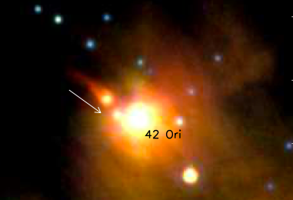
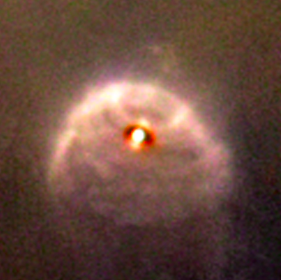
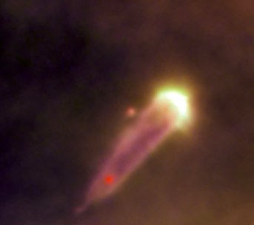
What are Proplyds, and
Why are we studying them?
Proplyd: externally photoevaporating protoplanetary disk.
Ionizing sources, O or B stars, emit UV radiation that causes photoevaporation.
The Proplyd Lifetime Problem:
Proplyd lifetime: 10⁴ - 10⁵ years
Disk lifetime in isolation: 1-3 Myrs:
The time it takes for gas giants, such as Jupiter, to form.
Above: Proplyd KCFF 1, Kim et al., 2016
Images from Hubble heic0917 Photo Release, 2009

Slide 3
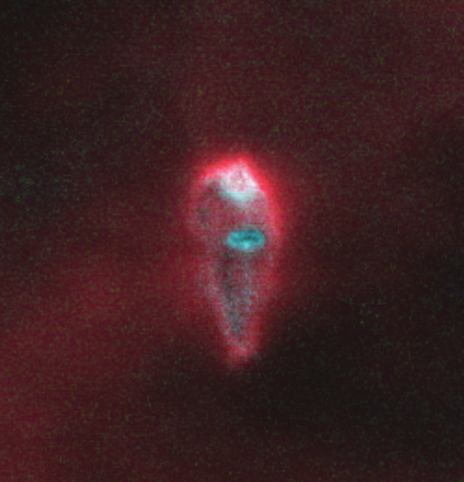
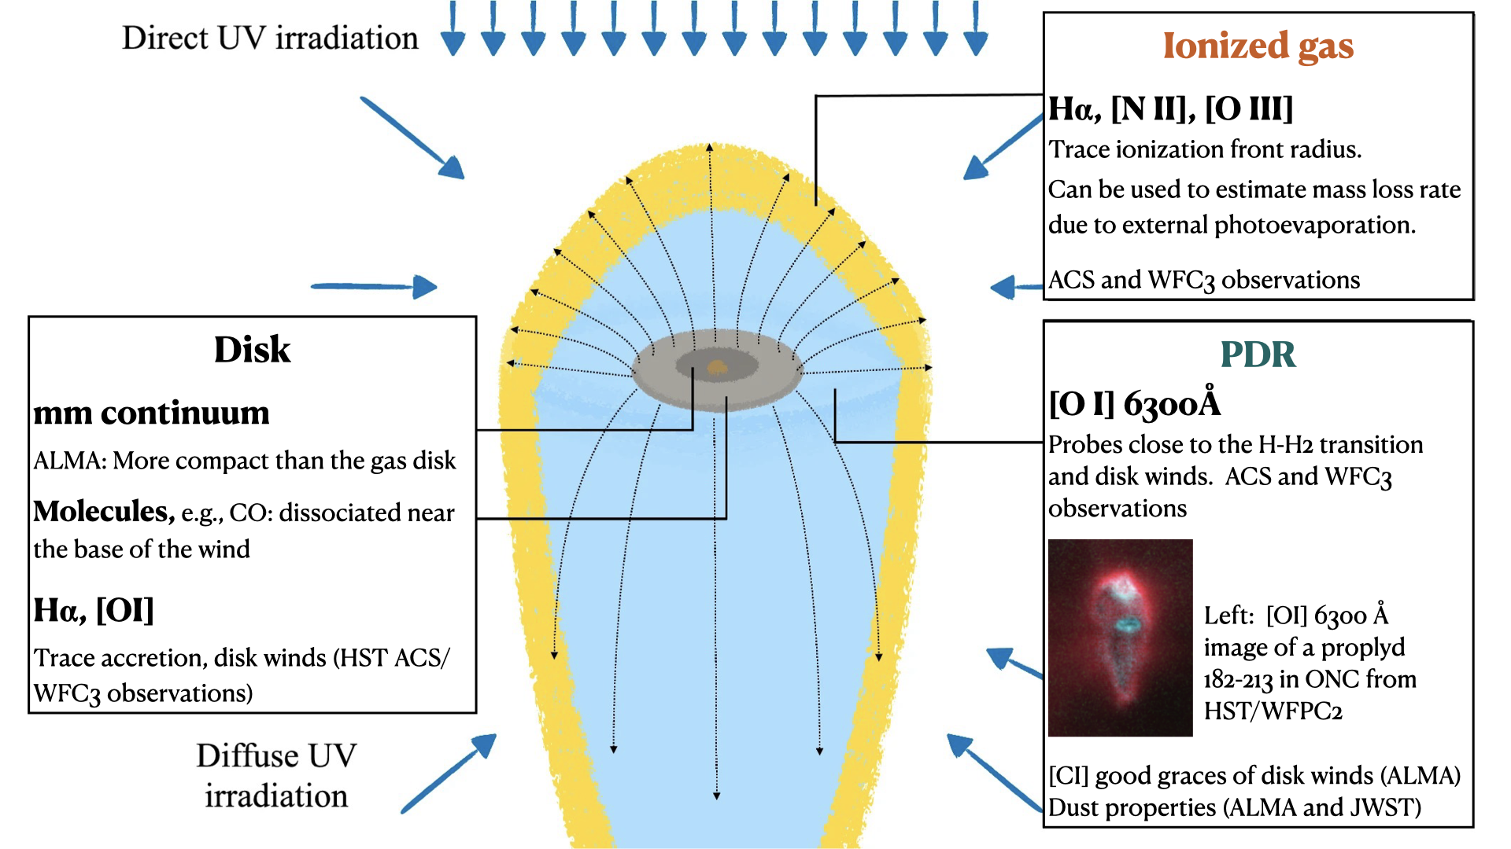
Proplyd Anatomy and Discovery
Left: Winter, A. J. and Haworth T. J. et al., 2022
Right: image of proplyd 182-213 in the ONC from HST/WFPC2

Slide 4
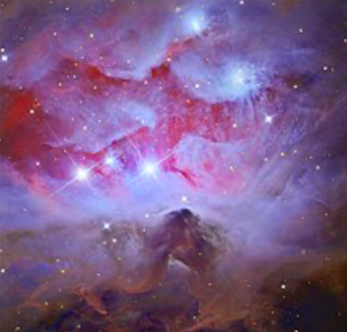
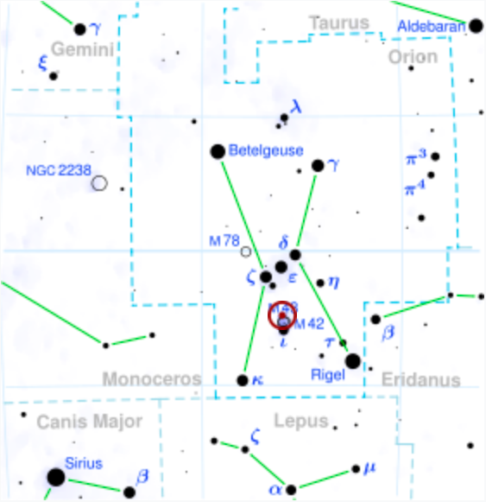
Why Study the Region NGC 1977?
Main ionizing source is 42 Orionis, a B1V (blue, main-sequence) binary star.
Level of UV radiation is around 3000 times as intense as in the neighborhood of our Solar System.
We believe this to be typical of most star-forming regions.
The region is (relatively) close, around 400pc. We can obtain kinematics data of individual YSOs and observe proplyds.
It is the lowest-UV environment in which proplyds have been discovered.
Images from Wikipedia - “42 Orionis”

Slide 5
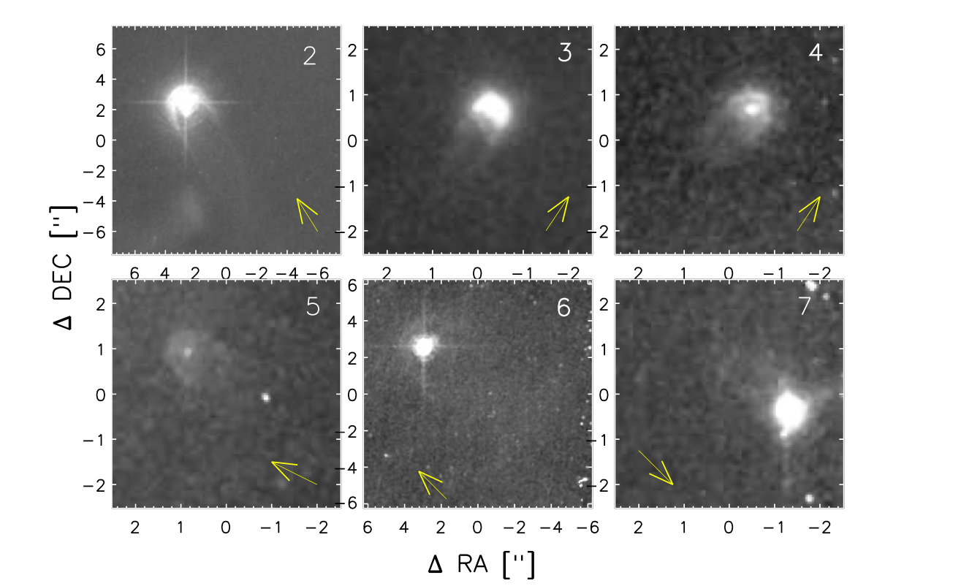
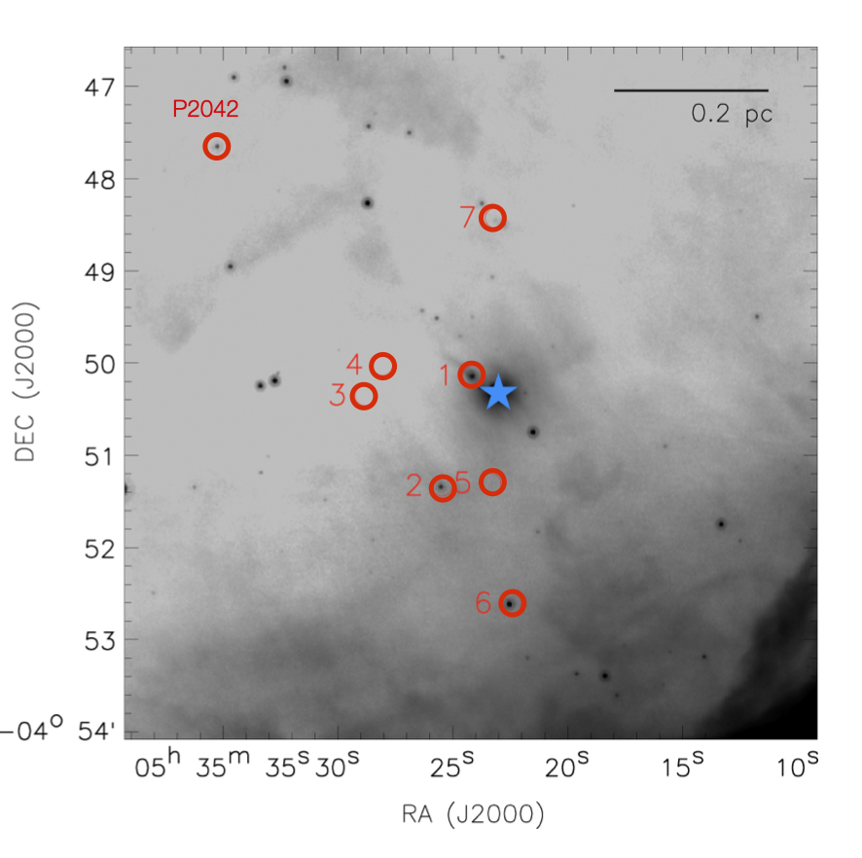
Proplyds in NGC 1977
Images from Kim et al., 2016

Slide 6
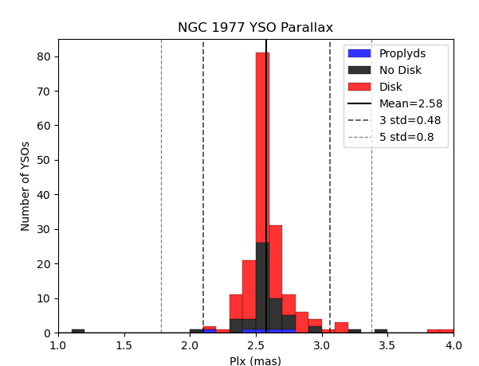
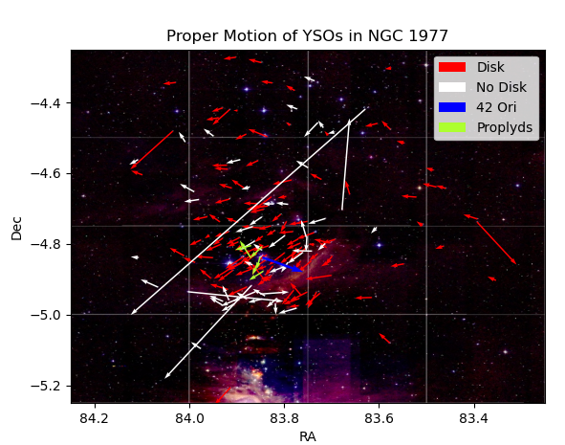
Defining Membership of NGC 1977
When removing “outliers”, there are many factors to consider besides measurement error alone:
RUWE, parallax, distance, luminosity, position in the sky
NCG 1977 YSO Parallax
Proper Motion of YSOs in NGC 1977
Number of YSOs
RA (J2000)
Parallax (mas)
Dec (J2000)

Slide 7
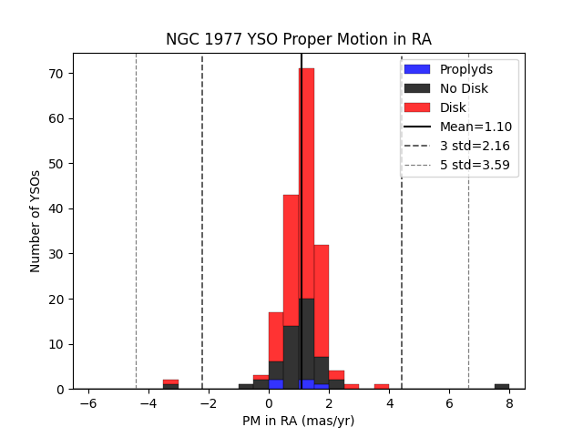
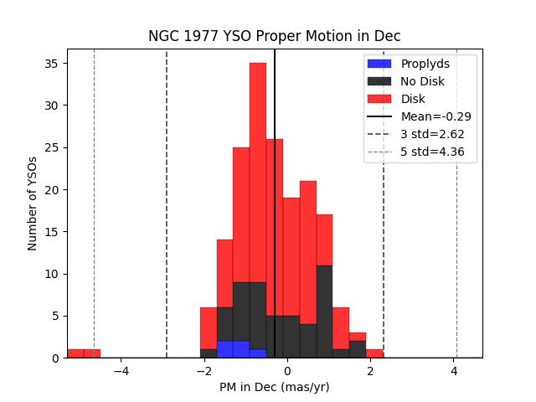
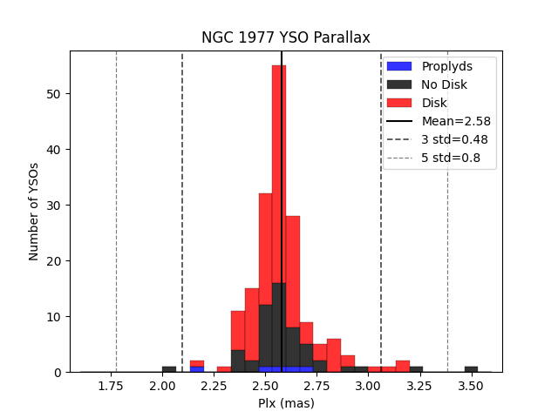
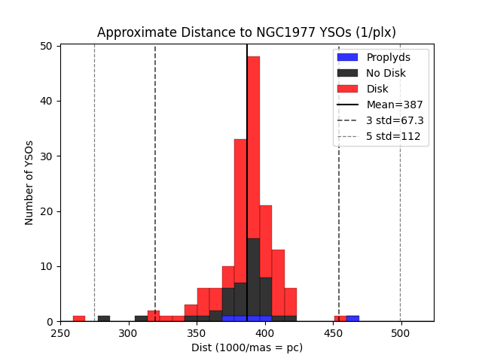
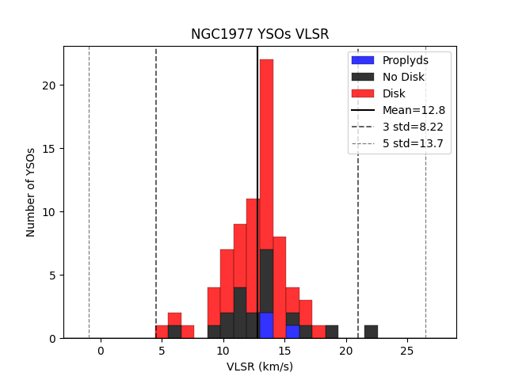
Defining Membership of NGC 1977

Slide 8
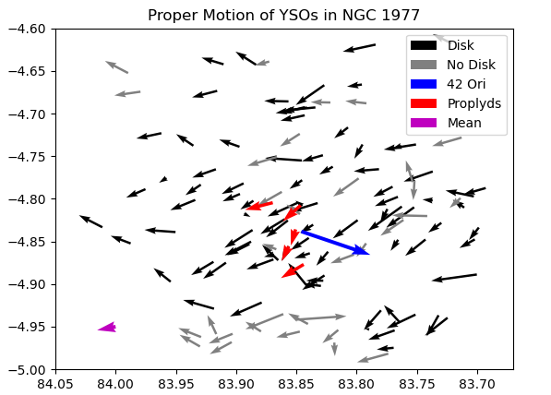
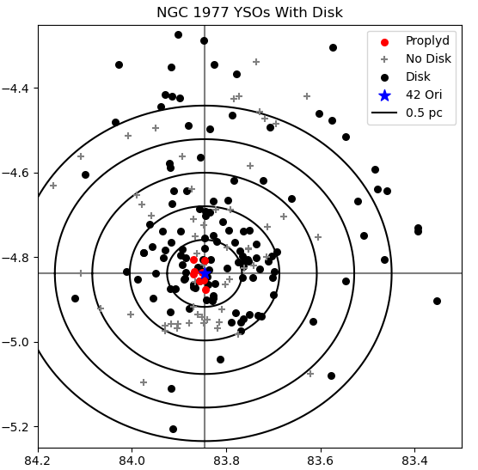
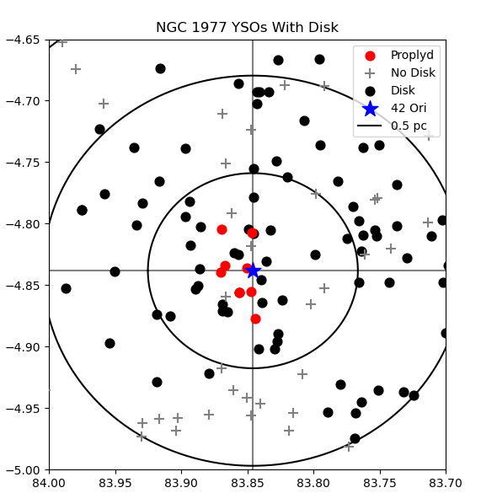
Additional Figures
Proper Motion of YSOs in NGC 1977
NGC 1977 YSOs With Disks
RA (J2000)
RA (J2000)
Dec (J2000)
Dec (J2000)

Slide 9
Conclusions and Future Study
Proplyd lifetime problem in NGC 1977 can be explained by kinematics: proplyds do not appear to spend enough time within 0.5 parsec of 42 Ori to lose their disks completely.
Continued study of external photoevaporation is crucial to our understanding of disk evolution and planet formation.
Continued observation of NGC 1977, surveying a larger region in the sky.
Analysis of other regions, including the Orion Nebula Cluster (ONC).
ONC has 10-30 times the amount of UV radiation as NGC 1977.

Slide 10
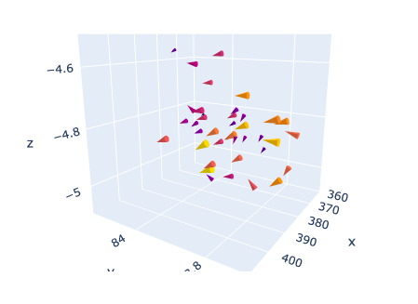
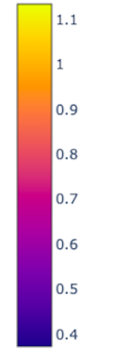
Conclusions and Future Study
Proper Motion and VLSR of NGC 1977 YSOs
Determining VLSR for remaining 4 Proplyds and 42 Ori.
More accurately determining distances to NGC 1977 YSOs.
Total Velocity (pc/0.5Myr)
DEC (J200)
Distance (pc)
83.8
RA (J200)

Slide 11
Acknowledgements
Dr. J. Serena Kim, Steward Observatory, University of Arizona Department of Astronomy
Peter Hartman, University of Arizona Space Grant Intern 2022-23
Michelle Coe and Dr. Chandra Hollifield Collins, Arizona Space Grant Consortium
Arizona Space Grant Consortium
The University of Arizona and Steward Observatory

Slide 12
Thank You

Slide 13
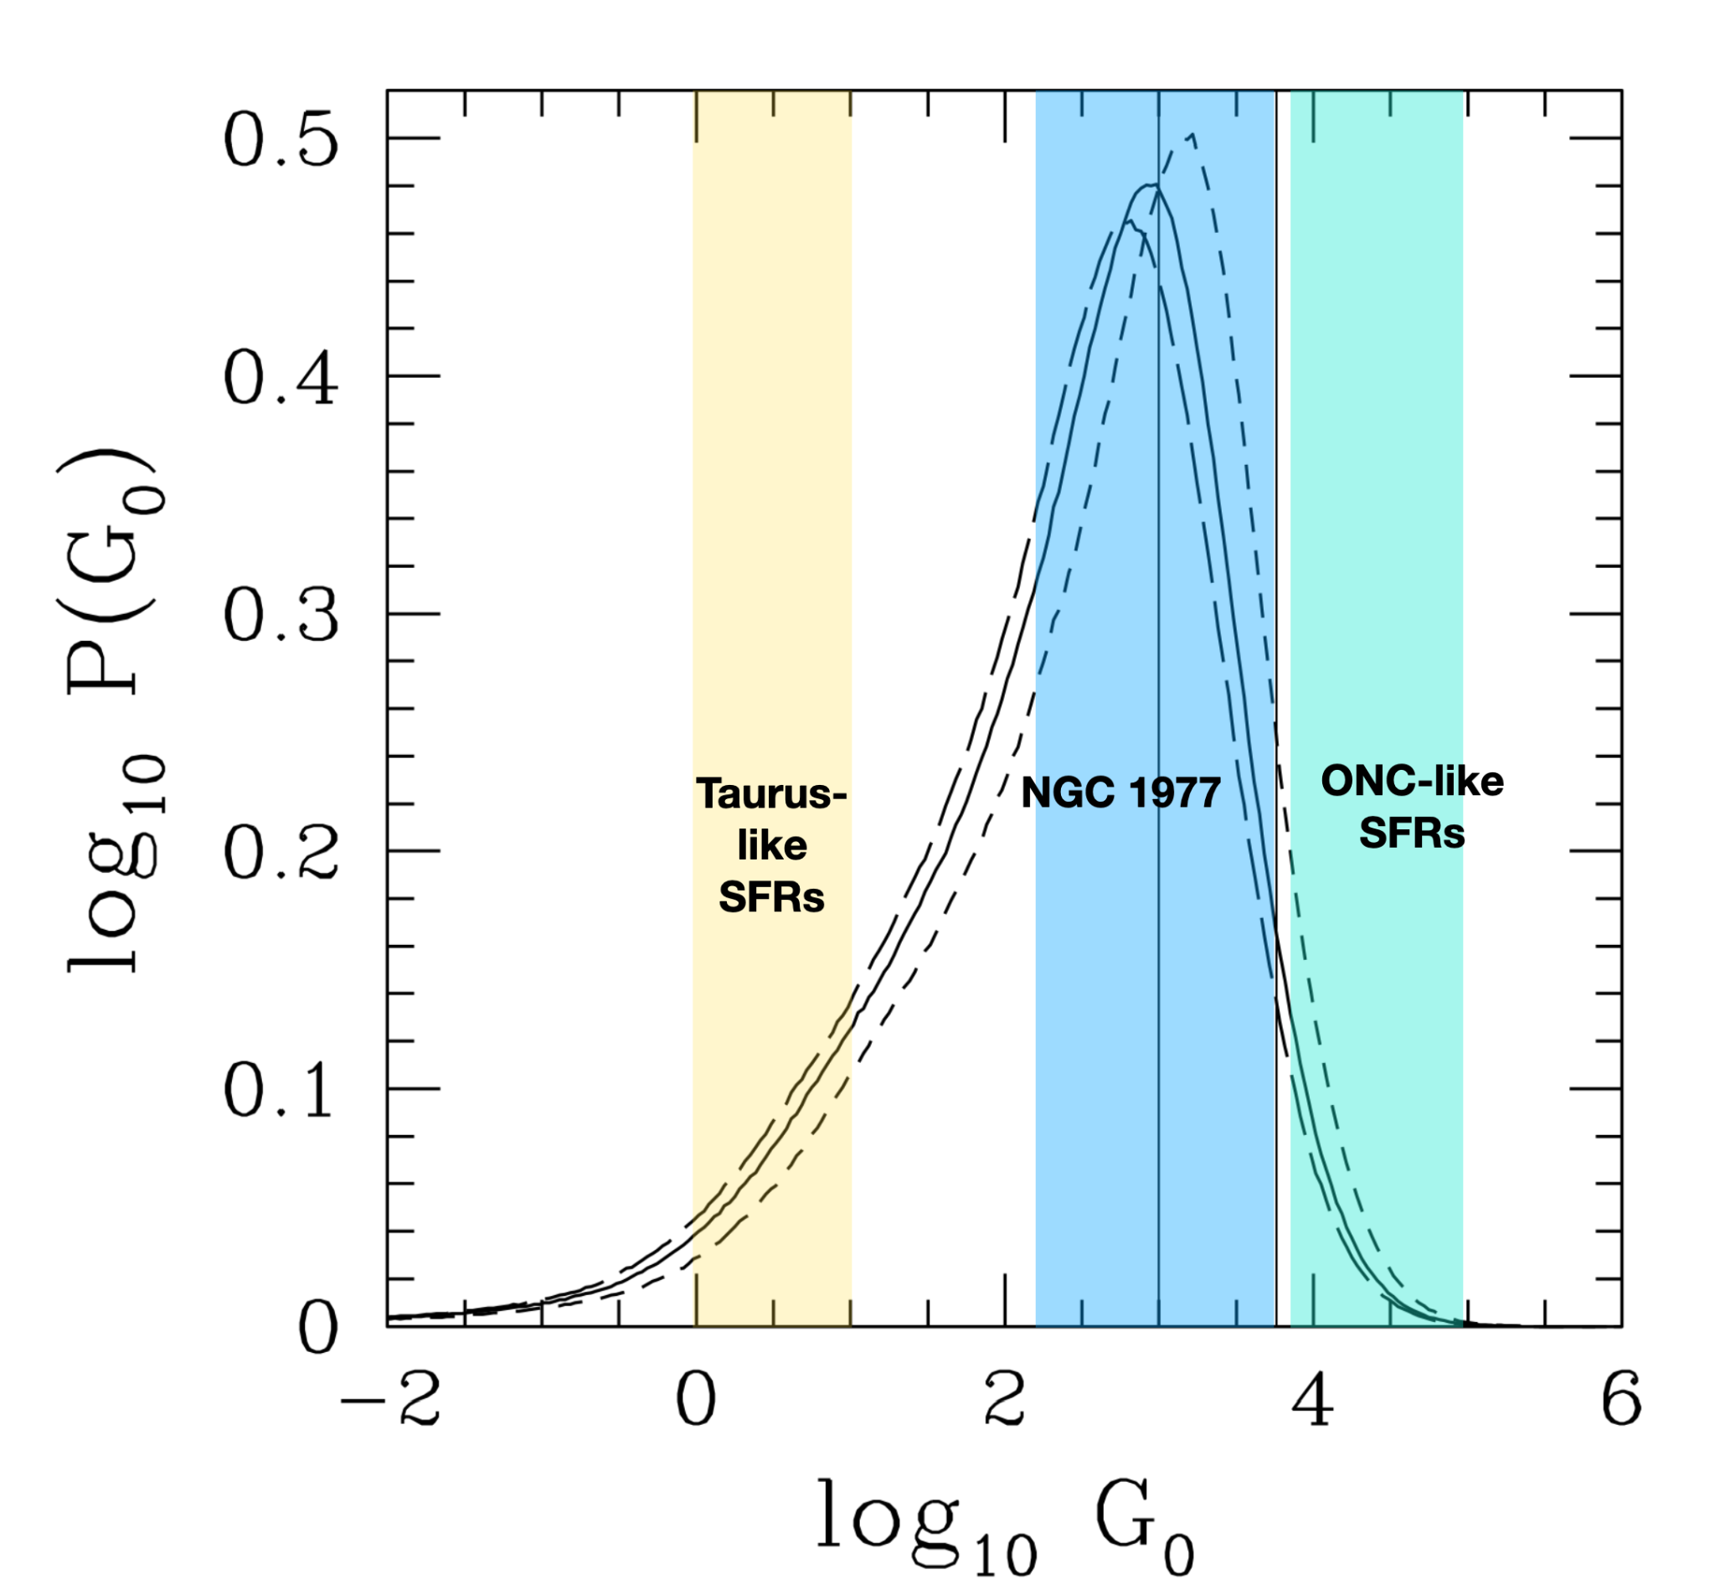
Probabilities of Different Radiation Levels in Star Forming Regions

Slide 14
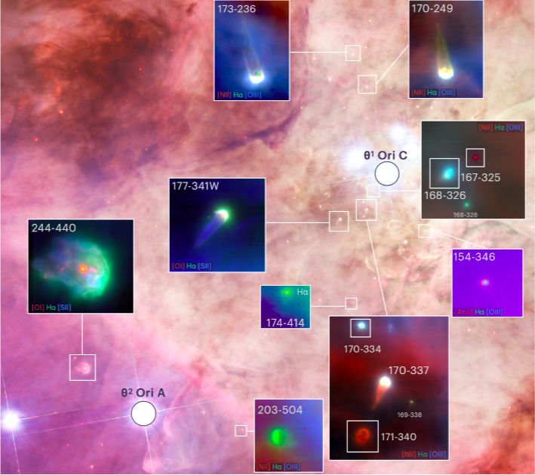
Proplyds In Orion Nebula Cluster

